Slide 1
CIS117 Week 2
Linux distros and how to do labs

Slide 2
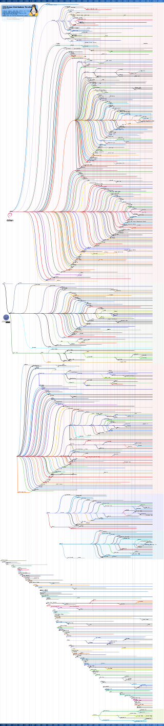
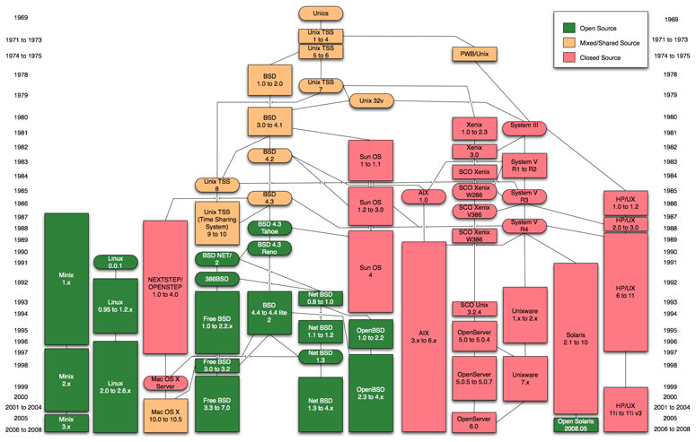
Linux Families
By Andreas Lundqvist (initially), Muhammad Herdiansyah (continued), Fabio Loli (continued) - http://futurist.se/gldt/ (initially), https://github.com/konimex/linuxtimeline (continued), https://github.com/FabioLolix/LinuxTimeline (continued), GFDL 1.3, https://commons.wikimedia.org/w/index.php?curid=2556373
https://www.computerworld.com/article/2524660/operating-systems/the-unix-family-tree.html

Slide 3
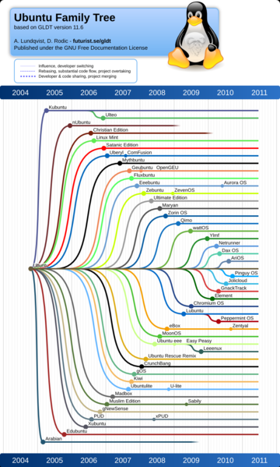
Ubuntu family tree
https://commons.wikimedia.org/wiki/File:Ubuntu_family_tree_11-06.png

Slide 4
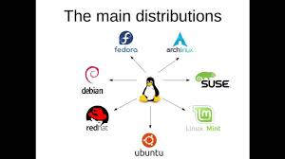
Linux family resemblance
Kernels
Variations
Installs
File location
Included software
Primary usage
https://www.youtube.com/watch?v=J0kxkqFEIe0

Slide 5
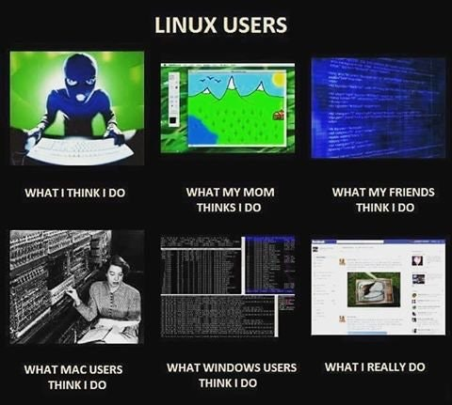
Linux users
Novice
Ubuntu
Mint
Advanced (or special purpose)
Debian
Kali
Qubes
https://www.reddit.com/r/linuxmasterrace/comments/62j1ed/linux_users/

Slide 6
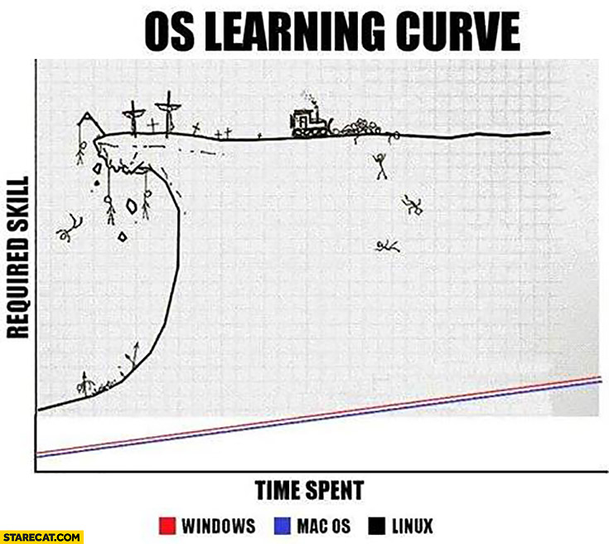
Labs
Server cis.necc.mass.edu
Username/password from instructor
SSH and SCP (not telnet or ftp)
WinSCP and PuTTy (Windows)
SSH and SCP on a Mac
Case matters!
Password doesn’t show, that’s normal
Don’t lose username/password!
https://starecat.com/memes/linux/page/2/

Slide 7
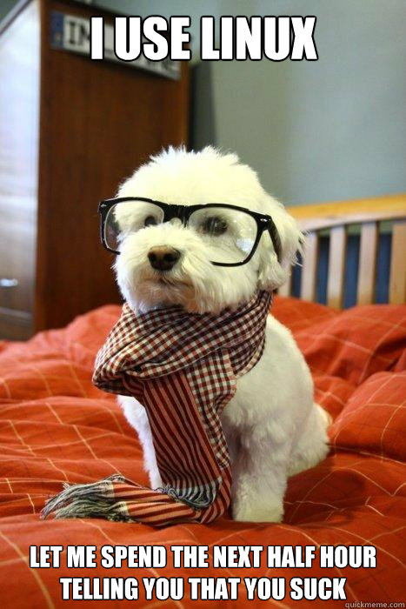
Local Linux
Computers boot into ubuntu
Ubuntu isn't the same distro as the server
BASH is still the same
http://ohsohumorous.com/index.php/funny-memes-OhSoHumorous-033995

Slide 8
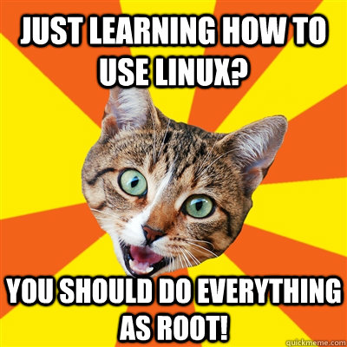
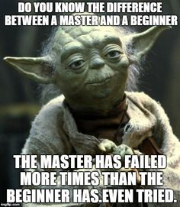
After lab login
You are at /home/username (home sweet ~)
What now?
ls
mv
cat
https://www.sqlhammer.com/sql-cruise-diary/
http://catplanet.org/just-learning-how-to-use-linux-cat-meme/

Slide 9
Help! Help!
What man is for
Web resources in blackboard
NECC tutoring
The required book Linux Pocket Guide

